Slide 1
PRONOUN SHARING AND STANCETAKING
Political and cultural (dis)alignment
Ann Coady
ann.coady@univ-montp3.fr

Slide 2
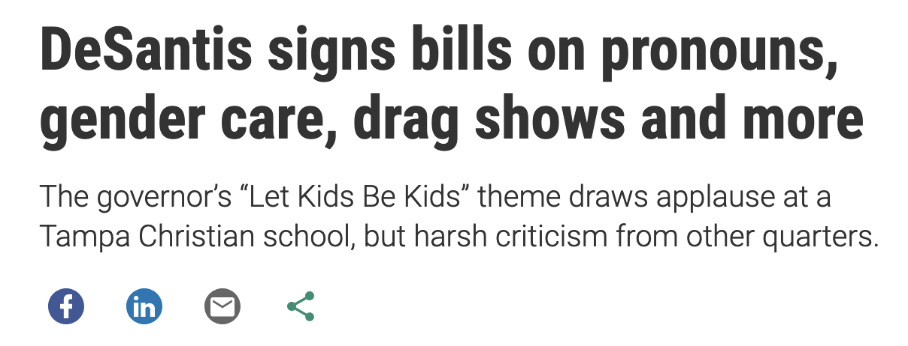
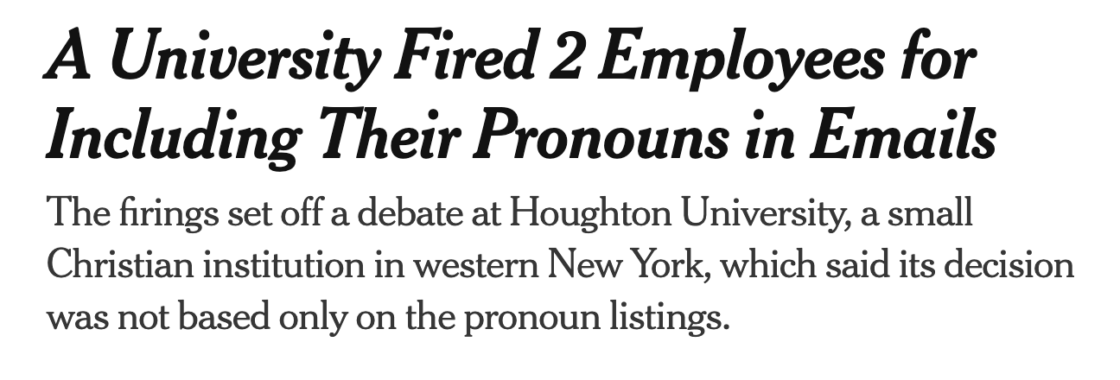
INTRO
CONCEPTUAL FRAMEWORK
CORPUS
RESULTS & ANALYSIS
CONCL
“Pronoun sharing and stancetaking: political and cultural (dis)alignment”
ann.coady@univ.montp3.fr

Slide 3
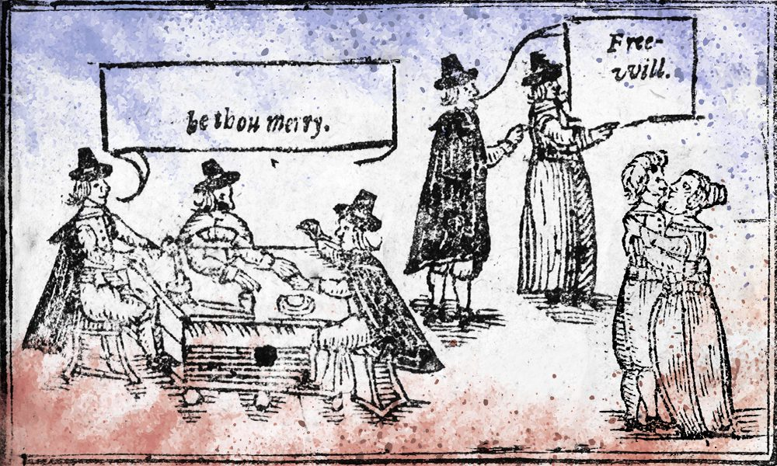
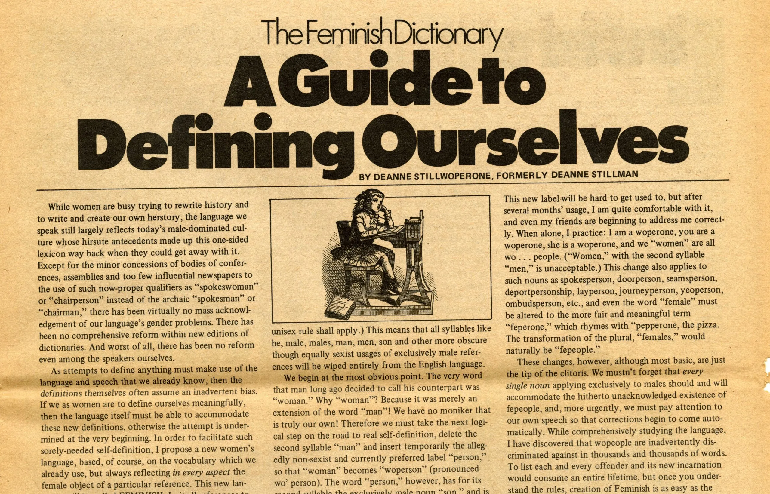
INTRO
CONCEPTUAL FRAMEWORK
CORPUS
RESULTS & ANALYSIS
CONCL
17th century England: disappearance of thee/thou
20th century USA / UK: avoidance of generic he
“Pronoun sharing and stancetaking: political and cultural (dis)alignment”
ann.coady@univ.montp3.fr

Slide 4
INTRO
CONCEPTUAL FRAMEWORK
CORPUS
RESULTS & ANALYSIS
CONCL
Main Qs:
Who shares their pronouns?
Why do they share?
What stances are they are attempting to claim?
What indexical values are linked to pronoun sharing?
“Pronoun sharing and stancetaking: political and cultural (dis)alignment”
ann.coady@univ.montp3.fr

Slide 5
INTRO
CONCEPTUAL FRAMEWORK
CORPUS
RESULTS & ANALYSIS
CONCL
SOCIOLINGUISTICS
Why speakers make specific linguistic choices
How and why those choices change over time and context
The social meaning of these choices
“Pronoun sharing and stancetaking: political and cultural (dis)alignment”
ann.coady@univ.montp3.fr

Slide 6
INTRO
CONCEPTUAL FRAMEWORK
CORPUS
RESULTS & ANALYSIS
CONCL
INDEXICAL ORDER
1st order indexicality indexes a particular social group (Labov’s “indicator”) in a neutral way, i.e. no social meanings or connotations are attached.
2nd order indexicality points towards social meaning (Labov’s ”marker”) e.g. sharing pronouns → left-leaning political orientation.
3rd order indexicality is when a variant has become “enregistered” and indexes a particular social type or stereotype (e.g. social justice warrior or “the pronoun crowd”).
“Pronoun sharing and stancetaking: political and cultural (dis)alignment”
ann.coady@univ.montp3.fr

Slide 7
INTRO
CONCEPTUAL FRAMEWORK
CORPUS
RESULTS & ANALYSIS
CONCL
STANCE
Interpersonal stance = how speakers mark or claim interpersonal relations with others in interaction, e.g. friendliness or authority
Stance = zero order indexicality / direct indexicality
1st, 2nd and 3rd order indexicality = indirect indexicality
[LEFT-LEANING]
[NON BINARY]
[YOUNG]
PRONOUN SHARING
STANCE
(e.g. caring)
(direct indexicality)
(indirect indexicality)
“Pronoun sharing and stancetaking: political and cultural (dis)alignment”
ann.coady@univ.montp3.fr

Slide 8
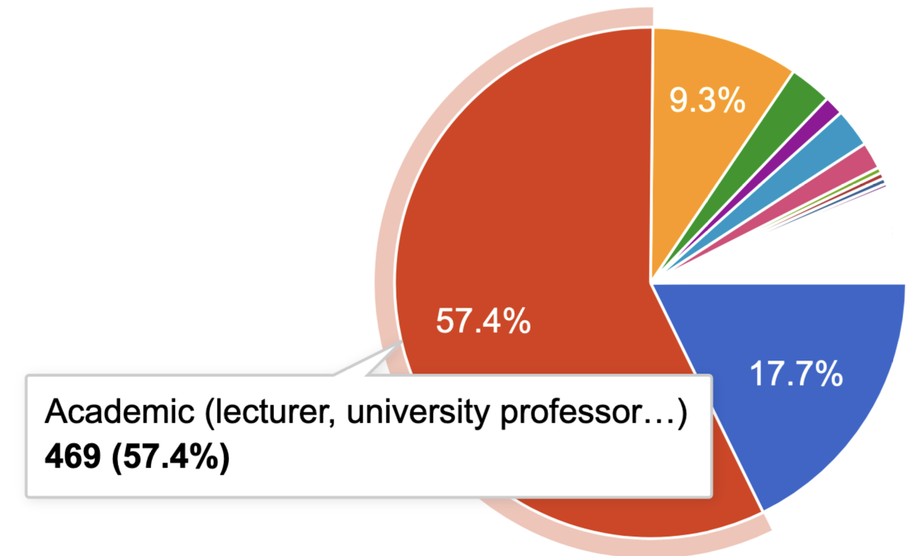
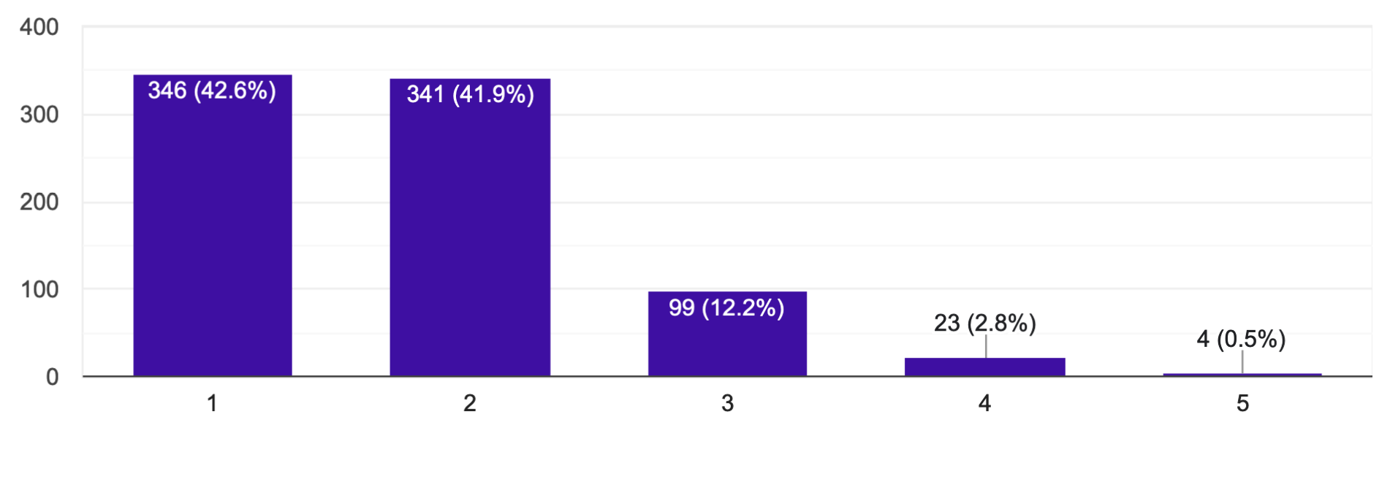
INTRO
CONCEPTUAL FRAMEWORK
CORPUS
RESULTS & ANALYSIS
CONCL
Weaknesses:
Linguistic mailing lists = academics on the political left
Didn’t ask which pronouns people use
Didn’t ask about sexuality
Student
145 (17.7%)
1 = left wing
5 = right wing
“Pronoun sharing and stancetaking: political and cultural (dis)alignment”
ann.coady@univ.montp3.fr

Slide 9
INTRO
CONCEPTUAL FRAMEWORK
CORPUS
RESULTS & ANALYSIS
CONCL
“Pronoun sharing and stancetaking: political and cultural (dis)alignment”
ann.coady@univ.montp3.fr

Slide 10
INTRO
CONCEPTUAL FRAMEWORK
CORPUS
RESULTS & ANALYSIS
CONCL
“Pronoun sharing and stancetaking: political and cultural (dis)alignment”
ann.coady@univ.montp3.fr

Slide 11
INTRO
CONCEPTUAL FRAMEWORK
CORPUS
RESULTS & ANALYSIS
CONCL
DO YOU SHARE YOUR PRONOUNS?
“Pronoun sharing and stancetaking: political and cultural (dis)alignment”
ann.coady@univ.montp3.fr

Slide 12
INTRO
CONCEPTUAL FRAMEWORK
CORPUS
RESULTS & ANALYSIS
CONCL
“Pronoun sharing and stancetaking: political and cultural (dis)alignment”
ann.coady@univ.montp3.fr

Slide 13
INTRO
CONCEPTUAL FRAMEWORK
CORPUS
RESULTS & ANALYSIS
CONCL
“Pronoun sharing and stancetaking: political and cultural (dis)alignment”
ann.coady@univ.montp3.fr

Slide 14
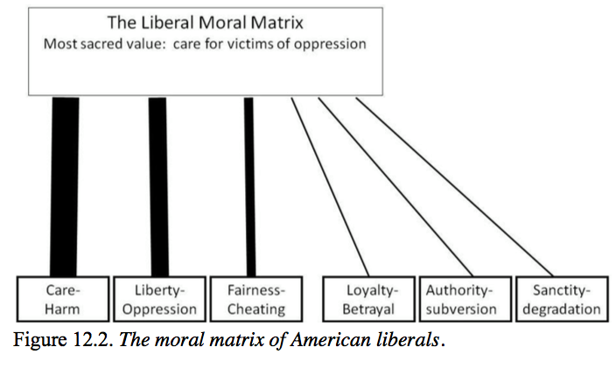
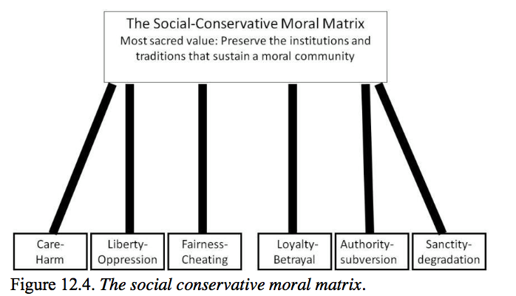
INTRO
CONCEPTUAL FRAMEWORK
CORPUS
RESULTS & ANALYSIS
CONCL
MORAL FOUNDATIONS THEORY
Graham, J., Haidt, J., & Nosek, B. A. (2009). « Liberals and conservatives rely on different sets of moral foundations ». Journal of Personality and Social Psychology, 96(5), 1029-1046.
“Pronoun sharing and stancetaking: political and cultural (dis)alignment”
ann.coady@univ.montp3.fr

Slide 15
INTRO
CONCEPTUAL FRAMEWORK
CORPUS
RESULTS & ANALYSIS
CONCL
THE INDEXICAL FIELD OF PRONOUN SHARING
······································· 3rd ORDER (enregistered voices) ········································
[SOCIAL JUSTICE WARRIOR]
[LEFT-WING ACADEMICS]
[“GENDER POLICE”]
[WOKERATI]
[THE “PRONOUN CROWD”]
······························ 2nd ORDER (real or imagined characteristics) ·····························
[PROGRESSIVE]
[BRAINWASHED]
[TOTALITARIAN]
[NARROW-MINDED]
[WOKE]
[OPEN-MINDED]
[GUILLIBLE]
[OLD FASHIONED]
[TRADITIONAL]
[CARING]
[PROTECTING THE OPPRESSED]
[SNOWFLAKE]
[POLITICALLY CORRECT]
[VICTIMHOOD]
[COMMON SENSE / REALIST]
··········································· 1st ORDER (groups of ppl) ··············································
[YOUNGER PPL]
[CIS-WOMEN]
[CIS-MEN]
[QUEER FEMINISTS]
[LGBTQIA+]
[GENDER CRITICAL FEMINISTS]
[RELIGIOUS BELIEVERS]
[LEFT-LEANING / PROGRESSIVES]
[OLDER PPL]
[RIGHT-LEANING / CONSERVATIVES]
····································· ZERO-ORDER INDEXICALITY (stances) ······································
[CARING / ALLYSHIP / SOLIDARITY]
[STANCE ON GENDER:
A SYSTEM OF OPPRESSION / LINKED TO SEX / OBVIOUS]
[POLITICAL]
[VIRTUE-SIGNALLING]
[CONFORMING]
[AVOIDING POLITICS]
[SELF-RIGHTEOUS]
[ABSURD]
[DON’T CARE / INDIFFERENT]
[COMMON SENSE]
[STANCE ON GENDER:
AN INNATE FEELING / PERFORMANCE / NOT OBVIOUS / DECOUPLED FROM SEX]
[AVOIDING VIRTUE-SIGNALLING]
[INDEPENDENT-MINDED]
[POLITICAL]
[POLITE]
[BLEND IN/LOW PROFILE]
[IMPOLITE]
[PRIVATE]
Notes:
White = sharing
Green = not sharing

Slide 16
REFERENCES
Brown, R. and Gilman, A. (1960) ‘The Pronouns of Power and Solidarity’, in T. Sebeok A. (ed.) Style in Language. Boston: MIT Press, pp. 253–276.
Eckert, P. (2008) ‘Variation and the indexical field’, Journal of Sociolinguistics, 12(4), pp. 453–476. Available at: https://doi.org/10.1111/j.1467-9841.2008.00374.x.
Graham, J., Haidt, J. and Nosek, B., A. (2009) ‘Liberals and conservatives rely on different sets of moral foundations’, Journal of Personality and Social Psychology, 96(5), pp. 1029–46.
Kiesling, S.F. (2009) ‘Style as Stance: Stance as the Explanation for Patterns of Sociolinguistic Variation’, in A. Jaffe (ed.) Stance: Sociolinguistic Perspectives. Oxford University Press, pp. 171–194.
King, B. and Crowley, A. (2024) ‘The future of pronouns in the online/offline nexus’, in L.L. Paterson (ed.) The Routledge Handbook of Pronouns. London: Routledge, pp. 74–85. Available at: https://doi.org/10.4324/9781003349891-7.
Silverstein, M. (1985) ‘Language and the Culture of Gender: At the intersection of Structure, Usage, and Ideology’, in E. Mertz and R.J. Parmentier (eds) Semiotic Mediation. Orlando: Orlando Academic Press, pp. 219–259.
Thomas-Hébert, C. (2022) ‘Énonciation des pronoms et subjectivités militantes dans l’activisme étatsunien contemporain:’, Revue française d’études américaines, N° 172(3), pp. 122–135. Available at: https://doi.org/10.3917/rfea.172.0122.
Tucker, L. and Jones, J. (2023) ‘Pronoun Lists in Profile Bios Display Increased Prevalence, Systematic Co-Presence With Other Keywords and Network Tie Clustering Among US Twitter Users 2015-2022’, Journal of Quantitative Description: Digital Media, 1, pp. 1–35. Available at: https://journalqd.org/article/view/3884/2984.
”Pronoun sharing and stancetaking: political and cultural (dis)alignment”
ann.coady@univ.montp3.fr

