Slide 1
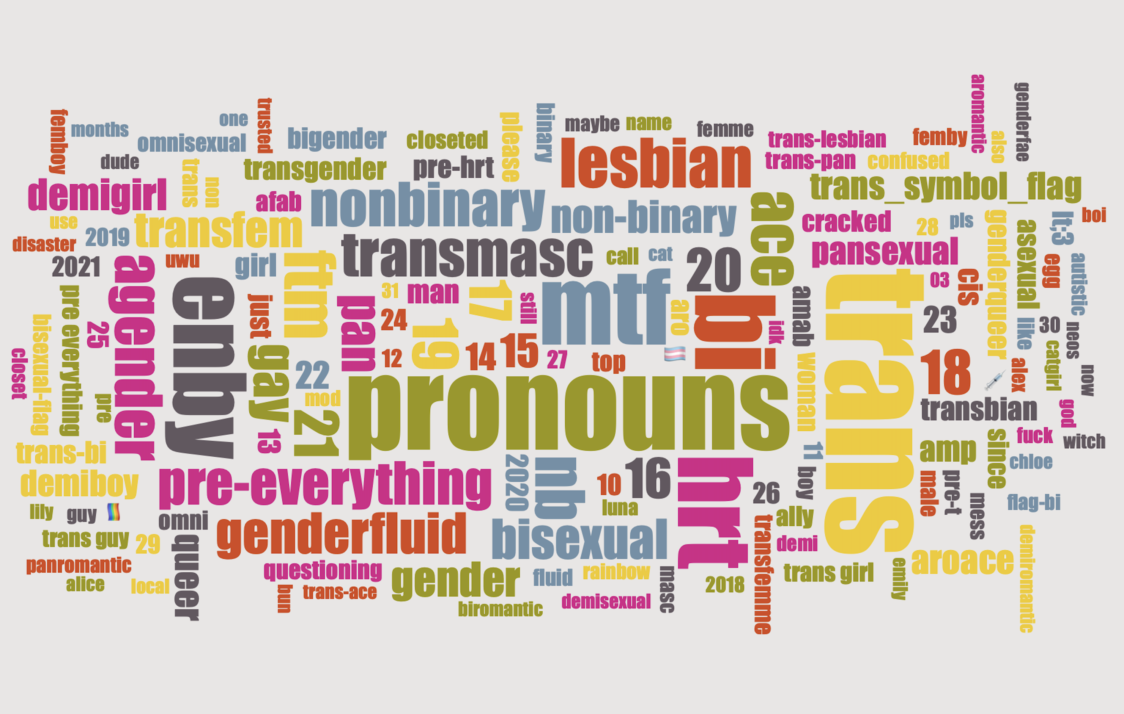
The Pronoun Declarers of Reddit
A Pronoun-Progressive Group of Speakers
Carlos Hartmann
<carlos.hartmann@es.uzh.ch>
Conference talk at “What’s your Pronoun?”

Slide 2
Overview
Reddit & (Pronoun) User Flairs
Study 1: Who are the Pronoun Declarers?
Study 2: Are they linguistically innovative?

Slide 3
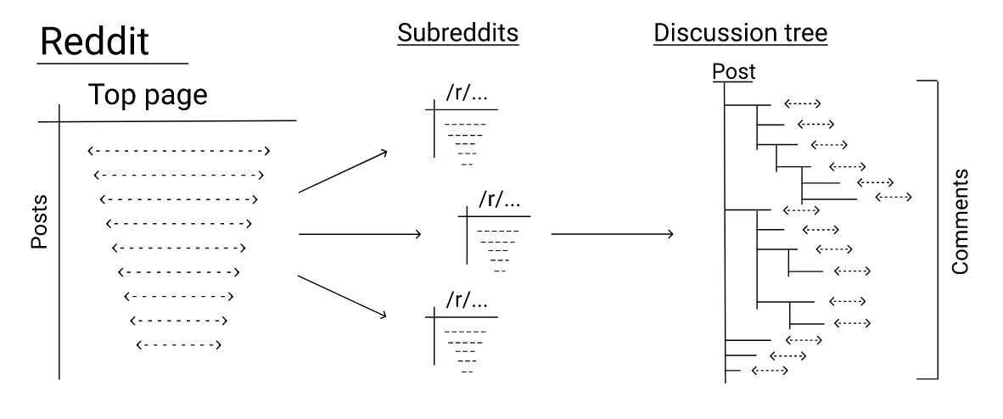
What is a Subreddit?
Public community on Reddit to share posts and discuss them
Usually no restriction on who can post and comment
Centers around a topic:
Locales
Interests
Political ideologies
Identity (Gender, race, age, …)
Sharing of content
(Medvedev, Lambiotte & Delvenne 2019: 3)

Slide 4
Pragmatics: Why “Pronoun Declarers?"
The conference uses the term “pronoun sharing”
I see the act of communicating one’s pronouns as the Declaration speech act following Searle (1975: 358-359)
“Declarations bring about some alternation in the status or condition of the referred to object or objects solely in virtue of the fact that the declaration has been successfully performed.”
Conrod (2019: chpt. 4.2) writes about the pragmatics of pronouns:
Using she implies acceptability of she for a particular referent (2019: 146)
Misgendering is a Positive FTA, correcting pronoun use a Negative FTA (2019: 153)
Usernames are the only form of gender expression in some online contexts
Bjorkman (2017: 6) reports that a username like moongirl17 is, an acceptable antecedent for they to younger speakers, meaning that usernames are not perceived as strong markers of gender
⇒ pronoun declarations are necessary in some online spaces

Slide 5
How does pronoun-declaring exist on Reddit?
In comment flairs first (introduced in October 2011):
Every comment by one user in one subreddit will display them next to the username
Flair remains community-specific
Flairs can (usually) be changed at any time
It depends on the subreddit:
How prominent the flairs are
If they are freely modifiable or chosen from a given list
If the user can change them at will or if they have to request them
If they are used at all

Slide 6
Study 1

Slide 7
Motivation
PhD project on singular they in social media data
Plausible overlap between singular they innovators and Pronoun Declarers
Pronoun Declarers easily identifiable
Exploratory study with RQ: Who declares their pronouns via user flair on Reddit and to what purpose?

Slide 8
Ethics and Precautions
Data collection limited to October 2021 to avoid LLM-generated material
Dataset not published, but made available to other researchers upon request
Legality double-checked by university’s legal counsel

Slide 9
Data Retrieval

Slide 10
Pronouns Considered (1)
Exclusions:
first and second person pronouns
Honorifics
one, oneself, that
names
Prompts to ask about pronouns
Preferences of one paradigm over another
Expressions such as pronounless or nullpronouns (unknown to me at the time)
Emojiself pronouns (cf. Lauscher, Crowley & Hovy 2022)
By paradigm:
he
she
they
any/all pronouns
no pronouns
Neopronouns
it
nounself pronouns
historical pronouns

Slide 11
Pronouns Considered (2)
Neopronouns:
a, a's, ae, aem, aemself, aer, aers, aerself, ala, alis, alum, ar, ay, aym, aymself, ays, ce, che, chim, chimself, chis, cir, cirs, cirself, co, cos, coself, Ct, de, dem, der, E, e, ee, ees, eeself, eet, Eir, eir, eirs, eirself, Em, em, ems, emself, en, ens, enself, Es, es, et, ets, etself, ey, eym, fae, faem, faer, faers, faerself, fe, feir, feirs, feirself, fem, femself, fer, fey, feym, fimself, fis, fm, gee, glug, glum, ha, hae, haes, haim, hais, ham, han, hans, hanself, har, he'er, he-er, he-she, heer, heesh, hei, heir, heirs, heirself, heis, hem, hemself, heoshe, her'er, herim, herimself, herimt, herimtself, heris, herm, hern, hes, hesh, heshe, hesher, het, hey, hez, hi, hier, hierself, hiez, him'er, him-er, him-her, himer, himerself, himmer, himoher, hin, hir, hirm, hirs, hirself, his'er, his'er's, his-er, his-ers, his-her, hisen, hiser, hisern, hiserts, hisoher, hizer, hizzer, ho, hod, hods, hom, hoo, hor, hors, horself, hos, hov, hse, hu, hu's, hum, hume, humeself, humit, hurm, hus, hy, hym, hymer, hymself, hys, hyser, idn, im, ip, ips, ir, iro, ith, iths, jee, jeir, jeirs, jem, jemself, jhe, judy, kin, kye, kyne, kynes, kyr, kyrself, le, lee, li, lim, limself, lin, lis, me, mef, meir, meirs, meirself, mem, memself, mes, meself, mim, mimself, mis, mun, na, nan, naself, ne, neir, neirs, neirself, nem, nemself, nim, nir, nirs, nirself, nis, nogen, nym, nymself, O, oo, ot, ou, per, pers, perself, po, re, ree, rim, ris, sap, se, sem, semself, ser, serself, shas, she'er, sheehy, shehe, sheir, sheirs, shem, shemself, shes, shey, shhe, shim, shims, shimself, shis, sie, sier, siers, sierself, sim, sin, sine, sir, sis, sit, su, ta, ta-men, tan, tas, te, tem, ter, tey, tha, thar, thare, thir, thon, thone, thons, thonself, tim, timself, tis, tra, trem, tres, tu, tum, tus, twem, twen, twens, twon, um, un, uns, ve, ver, vers, verself, vey, vi, vim, vir, virs, virself, vis, voi, void, voids, voidself, ws, wself, xe, xeir, xeirs, xeirself, xem, xemself, xen, xer, xers, xerself, xes, xey, xie, xies, xim, ximself, xir, xirself, xis, xiself, xyr, xyrs, yo, z, zan, zans, zanself, ze, zed, zeds, zedself, zeir, zeirs, zeirself, zem, zemself, zey, zhe, zheir, zheirs, zhem, zhemself, zher, zhers, zherself, zhey, zhim, zhir, zhirs, zhirself, zie, zim, zimself, zir, zirs, zirself, zon, zyhe, zyhe's, zyhem, zyhes, þane, þe
Present-Day English:
she, her, hers, herself
he, his, him, himself
they, their, theirs, them, themselves, themself
it, its, itself
Historical:
hē, hine
hēo, heo, hie, hīe, hiere
hit
hine, hisse, hes, him-seluen
sche, scheo, scho, sho, ȝho, heo, hie, hies, hire, hio, heore, heo-seolf
þa, þei, þeo, þo, þem, þeir, þam-selue
hit, hit sulue
Notes:
Potential(!) pronouns, not found ones

Slide 12
Pronouns Found
Neopronouns:
a, ae, aei, aem, aemself, aer, aers, aerself, aes, aeself, ajay, avi, aviself, ay, ayen, be, beir, beirs, bem, bey, bin, bl, bloo, cae, ce, cer, ci, cim, cimself, cin, cir, cirs, co, col, cos, dae, daem, daer, de, def, dem, der, dew, dey, die, dies, div, e, ee, eir, eirs, eirself, em, ems, emself, emselves, en, ens, er, ere, es, evi, ey, eyr, fae, faei, faem, faen, faer, faers, faerself, fai, fau, faun, fe, fea, feam, fear, fei, feir, fem, femself, fen, fer, fey, feyr, fim, fir, fiz, fla, flae, gho, gli, grim, ha, hai, he, hem, hex, hey, hi, hin, hir, hirs, hirself, ho, hor, hors, hos, hoself, hu, hum, humselves, hx, hy, hym, i, iel, im, ir, jae, jee, jem, ke, ki, kirs, kor, kyuu, le, lee, lel, lels, leself, lim, lun, mare, me, mel, melself, mim, mis, mo, mon, mur, myre, ne, neb, neir, neirself, nem, nemself, ner, ni, nir, nirs, nis, niself, no, nol, nor, nov, np, nur, nuris, ny, nya, nye, nyem, nyer, nym, nyr, o, onu, onun, or, ous, per, pers, pez, phe, phen, phex, pix, pixi, pri, prin, ra, rm, ro, roe, sae, saer, salabim, se, sei, seir, sem, ser, sey, shem, shey, shi, shim, shir, shklee, shklerr, shklim, shklimself, si, sie, sim, sis, sof, sol, ste, sy, ta, te, tem, temself, ter, ters, terself, tes, teself, tey, thee, ther, thil, thim, thon, thons, thonself, tik, tiz, tod, tods, un, uns, unself, unxelf, vae, vaem, vaer, ve, vei, vem, ven, ver, vers, verself, vey, vi, vim, vimself, vin, vir, virs, virself, vis, vo, voe, voh, voi, vy, vym, vyr, wir, wol, wy, wyr, wyrm, wyrmself, xa, xae, xame, xane, xar, xargle, xe, xei, xeir, xem, xemself, xer, xerneas, xers, xerself, xet, xey, xi, xie, xiem, xier, xiey, xim, ximself, xir, xirs, xirself, xis, xiself, xy, xym, xyr, xyrs, xyrself, ye, yee, yim, yin, yip, zae, zaer, zair, zala, zalad, zan, zans, zanself, zay, ze, zeah, zed, zee, zeir, zem, zer, zers, zey, zhe, zhem, zher, zhey, zhim, zhir, zi, zie, zim, zir, zirs, zirself, zit, znik, zom, zr, zy, zym, zymself, zyr
Present-Day English:
she, her, hers, herself
he, his, him, himself
they, their, theirs, them, themselves, themself
it, its, itself
Historical:
hine
heo
þei
Notes:
Potential(!) pronouns, not found ones

Slide 13
Resulting Dataset
≈3M comments
≈72M tokens
≈40K unique users
≈35K unique user flairs (Manually categorized by declared pronoun(s))
From ~1’500 different subreddits
Starting in 2012

Slide 14
Qualitative Results

Slide 15
Qualitative – Identity Expression
“[…] Passing is horribly cisnormative|I WANT TO PASS”
“Jessie is a girl, not a boy shut up shut up shut up (she/her)”
“aaaaaaaaaasaaaa(she/her)aaaaaaaaaaaaaaaaaaaaaaaaaaaaaaaaaaaaaaaa” [sic]
“She/they/???”
for now
“This user is [pronoun]/[pronoun]” (given option)

Slide 16
Qualitative – Pragmatics
“no fem compliments”
290 flairs include please, pls, or plz
= overt face-threatening act (cf. Conrod 2019: 153)
Of those, 67.5% include a non-binary pronoun (pronoun choice other than he or she)
Are nonbinary pronouns more face-threatening than binary pronouns?

Slide 17
Qualitative – Humor
“he/she/they? no lo se.”
“he/her/their I don’t care”
“her/she, cause im chocolate”
“He/They/Windows XP error sound”
“too old for this she/he/it” -- same joke in 1974 recorded by Baron (2020: 227)

Slide 18
Pronoun Declarations by Transgender Redditors
Gender identity (often with a flag)
Sexual orientation (often with a flag)
Information about transition milestones
egg, hatched (often with emojis)
(still) questioning
coming out
socially transitioned
HRT (sometimes political statements wrt to the (un)availabilty of HRT)
surgery
all of the above often summarized as pre-everything
Personal name
Pronouns
Age
Relationship status
Descriptive/witty remarks about their individual situation discourse/pragmatic/emphatic markers about respecting their pronouns and identities.

Slide 19
Quantitative Results

Slide 20
she declarations often observed to be much more frequent than, e.g., he. (Shugars et al. 2023 inter alia)

Slide 22
Most common neopronouns on Reddit
# | Neopronoun | Raw Freq | Relative Freq (%)
1 | xe | 950 | 18.3
2 | fae | 398 | 7.7
3 | ze | 327 | 6.3
4 | xem | 312 | 6
5 | neopronouns/neos/nps | 288 | 5.5
6 | ey | 261 | 5
7 | em | 187 | 3.6
8 | faer | 167 | 3.2
9 | ae | 148 | 2.8
10 | zir | 114 | 2.2

Slide 23
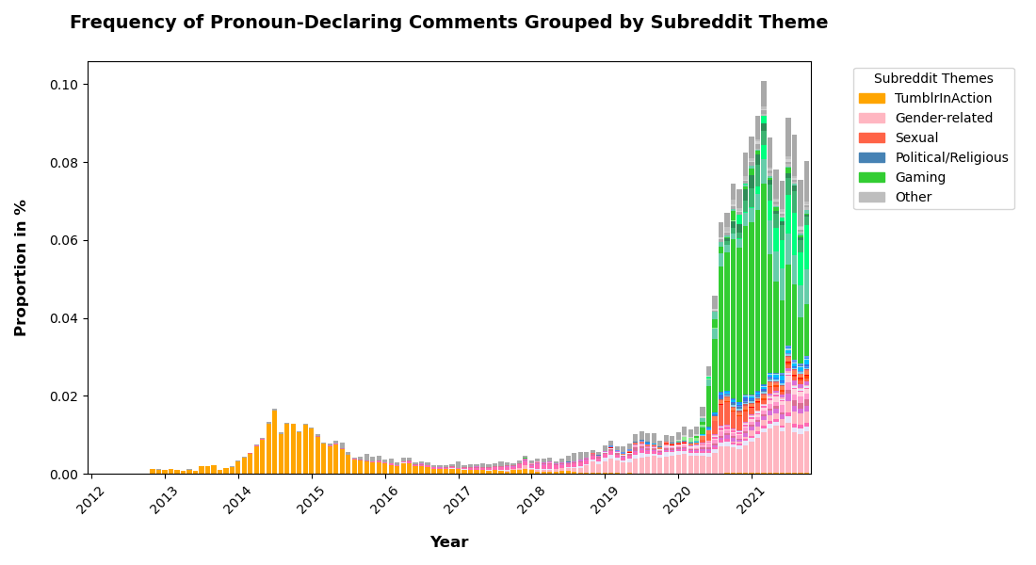
Pronoun Declarations on TumblrInAction are overwhelmingly Mock Pronouns (cf. talk by Heidt at the same conference)

Slide 24
Why those gaming communities? (correspondence with moderator team of RoyaleHighTrading)
Royale High is a game within Roblox
Centered around roleplaying and dressing up (avatars / personae)
Explicit invitation to “manufacture multiple versions of their own identities” (Coupland 2016: 447)
Directed at a younger audience
Other gaming communities with relatively high % of Pronoun Declarers:
RoyaleHighTrading, Cross_Trading_Roblox, crosstradingrblx
hogwartswerewolvesB, hogwartswerewolvesA, HogwartsWerewolves
GachaClub
Gamingcirclejerk

Slide 25
Conclusion Study 1
Pronoun Declaring on Reddit was ironic & derisive at first
The share of gender-related discussion grew starting around 2019 and the pandemic brought about a large increase in Pronoun Declarers
Most notably from gaming communities
Potentially points to age influence (cf. Bjorkman 2017: 5; Conrod 2019: 112; Moulton et al. 2020)
Contexts where pronouns as identity markers are crucial
Emphasizes that usernames are not enough to infer gender (cf. Bjorkman 2017: footnote 9)
Transgender and nonbinary communities have more elaborate pronoun flairs
Majority of female-identifying people (expected as per Nevalainen 2000: 38; Shugars et al. 2023)
The Pronoun Declarers of Reddit are a somewhat heterogenous group of mostly young, female-identifying, gender-aware, and often trans speakers, most of which are active in like-minded communities, where pronouns matter more than usual

Slide 26
Study 2

Slide 27
Generic they vs singular they
Any teacher / a lawmaker / someone … they
Grammatically singular
Semantically number-neutral / general
My spouse / the backstage puppeteer / Nemo … they
Unambiguously singular
Gender is hidden / unknown / affirmed as non-binary

Slide 28
Singular Themself
“[…] I'm sure OP has beaten themselves up. There is nothing you can say that they haven't already said to themself. […]”
ongoing variation
However, the enby use of "they" does differ from standard grammar in one small but significant detail. In order to reinforce the fact that the pronoun is being used in its singular (not plural) meaning, the enby folks that I know prefer to say "themself" rather than "themselves" - as in "They bought themself new trainers." :)
Metalinguistic awareness + anecdotal evidence
themself observed as acceptable to younger, gender-progressive, and non-binary speakers, though also influenced by referent (Conrod & Ahn 2023)
Notes:
Read the first sentence aloud

Slide 29
Study Design
RQ: What is the state of themself usage in the dataset?
H1: Singular and generic themself are still minority forms overall.
H2: Pronoun Declarers are more likely to use themself in singular and generic reference compared to their non-declaring counterparts.
Baseline 1:
Same subreddits as Pronoun Declarers
No flair or flair not matching any of the used regex patterns (no manual checking, however)
Exactly same number of comments per month per subreddit, randomly chosen
Baseline 2:
From any other subreddit
Same number of comments per month, randomly chosen

Slide 30
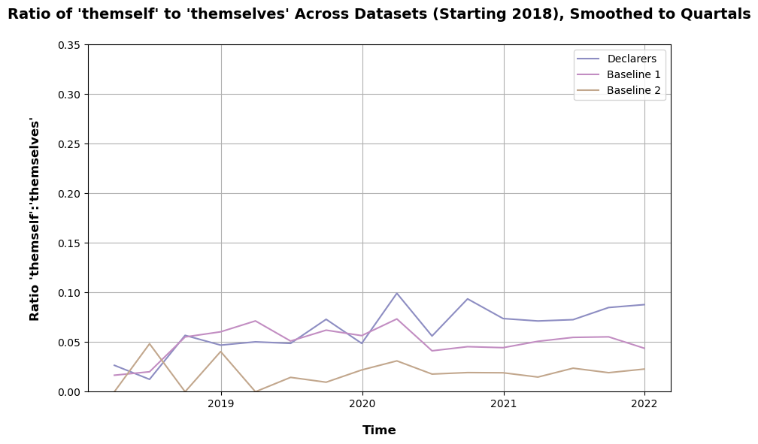
significant upward trend!
(Spearman’s Ranked Correlation, p=1.33e-04)
no significant change.
(p = 0.797 > 0.01)

Slide 31
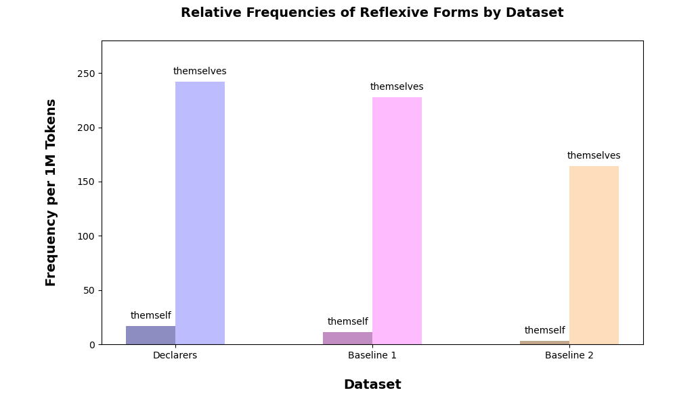
significant!
(log likelihood test, p≈0)

Slide 32
Generic use much more common than singular, as previously described (Foertsch & Gernsbacher 1997; Sanford & Filik 2007;)

Slide 33
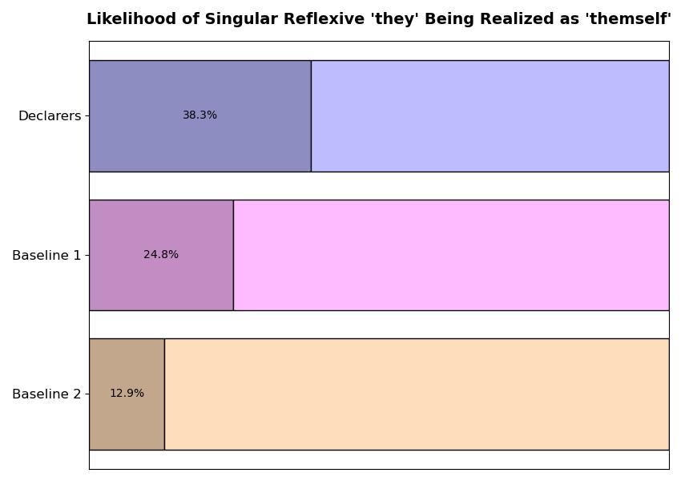
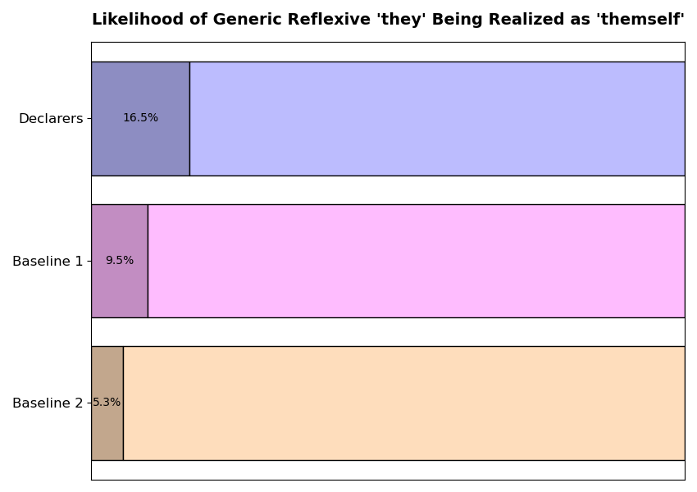
both significant!
(Logit Regression, p=8.89e-12 & 7.28e-21)

Slide 34
Conclusion Study 2
H1: Singular and generic themself are indeed still a minority form
H2: Pronoun Declarers are indeed more likely to use it in singular and generic reference than their non-declaring counterparts
This supports the insights from Conrod & Ahn’s (2023) ongoing work
The results also show that this is currently happening language change
Started by people with same general profile as Declarers
No evidence here of themself spreading outside of these circles, however

Slide 35
Acknowledgements & References

Slide 36
A big thank you to…
The moderators of:
/r/RoyaleHighTrading
/r/bropill
/r/MoneyDiariesACTIVE
/r/KarlJacobs
/r/BDSMnot4newbies
Memoria Matters for keeping me entertained with her content while annotating tens of thousands of user flairs

Slide 37
References (1)
Baron, Dennis E. (2020): What’s your pronoun? beyond he & she. New York: Liveright Publishing Corporation.
Bjorkman, Bronwyn M. (2017): Singular they and the syntactic representation of gender in English. Glossa: a journal of general linguistics 2(1) doi:10.5334/gjgl.374.
Conrod, Kirby (2019): Pronouns Raising and Emerging. University of Washington (= Ph.D. thesis).
Conrod, Kirby & Byron Ahn (2023): Who accepts “themself?” Sociosyntactic variation in English -self reflexives. Talk presented at the 2023 annual meeting of the LSA. Denver, USA.
Coupland, Nikolas (2016): Five Ms for Sociolinguistic Change. In Nikolas Coupland (ed.), Sociolinguistics: theoretical debates, 433–454. Cambridge New York: Cambridge University Press.
Lauscher, Anne, Archie Crowley & Dirk Hovy (2022): Welcome to the Modern World of Pronouns: Identity-Inclusive Natural Language Processing beyond Gender. In Nicoletta Calzolari, Chu-Ren Huang, Hansaem Kim, James Pustejovsky, Leo Wanner, Key-Sun Choi, Pum-Mo Ryu, et al. (Hrsg.), Proceedings of the 29th International Conference on Computational Linguistics, 1221–1232. Gyeongju, Republic of Korea: International Committee on Computational Linguistics.

Slide 38
References (2)
Medvedev, Alexey N., Renaud Lambiotte & Jean-Charles Delvenne (2019): The Anatomy of Reddit: An Overview of Academic Research. Dynamics On and Of Complex Networks III, 183–204. Springer International Publishing. doi:10.1007/978-3-030-14683-2_9.
Moulton, Keir, Chung-hye Han, Trevor Block, Holly Gendron & Sander Nederveen (2020): Singular they in context. Glossa: a journal of general linguistics 5(1) doi:10.5334/gjgl.1012.
Nevalainen, Terttu (2000): Gender Differences in the Evolution of Standard English: Evidence from the Corpus of Early English Correspondence. Journal of English Linguistics 28(1). 38–59. doi:10.1177/00754240022004866.
Searle, John R. (1975): A Taxonomy of Illocutionary Acts. In K. Gunderson (ed.), Language, Mind and Knowledge, 344–369. University of Minnesota Press.
Shugars, Sarah, Alexi Quintana-Mathé, Robin Lange & David Lazer (2023): Categorizing the non-categorical: the challenges of studying gendered phenomena online. Journal of Computer-Mediated Communication 29(1) doi:10.1093/jcmc/zmad053.

Slide 39
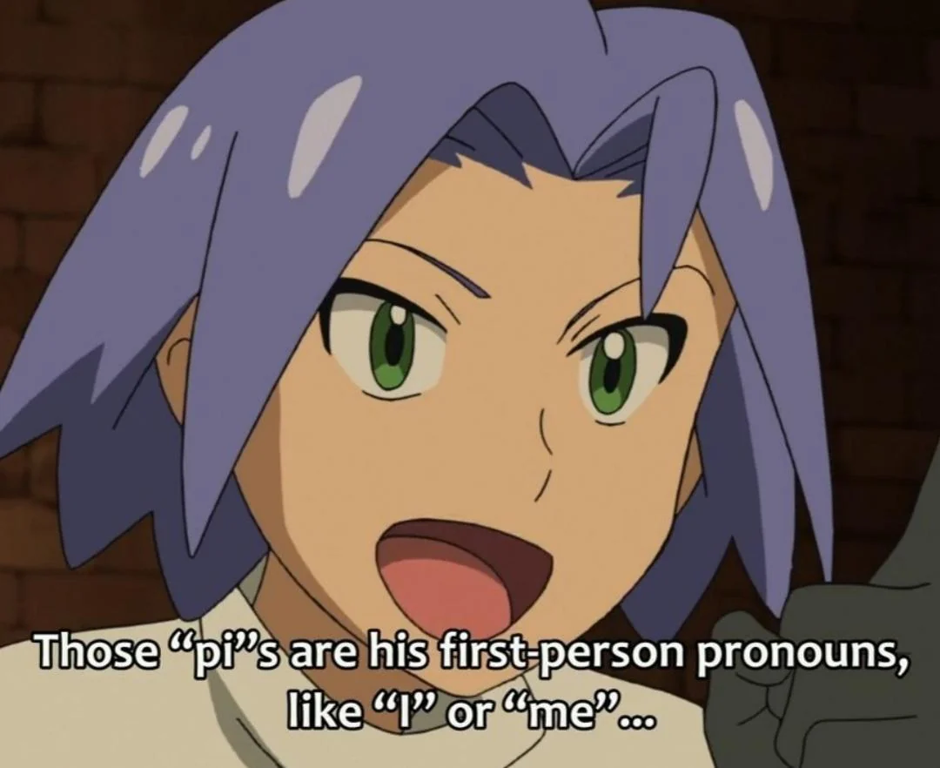
Thank you for your attention!

Slide 40
Additional Slides

Slide 41
Data Extraction
Using offline copy of the dataset created by Baumgartner et al. (2020)
Pronouns:
Pre-extraction of all comments with a user flair matching the regex <\b[a-zA-Z]+/[a-zA-Z]+\b> (letters divided by a slash)
Extraction of flairs containing any pronoun based on manually compiled collection of English pronouns based on Baron (2020) and various online sources, including neopronouns and historical pronouns
Other declarations:
No/any/all pronouns: extraction of comments with flair matching regex <(no|any|all).pronouns?>
Nounself pronouns: extraction of comments with flair matching regex <(.+)/\\1s(elf)?\\b>, manually filtered for false positives
Flairs matching “neopronouns”, “neos”, “nps”
Categorized every flair automatically, double-checked manually (35’304 unique flairs)

Slide 42
Subreddits with the Highest Number of Pronoun-Declaring Comments
Subreddit | Count
RoyaleHighTrading | 1006381
traaaaaaannnnnnnnnns | 420930
Gamingcirclejerk | 185260
GachaClub | 141870
TumblrInAction | 139700
Cross_Trading_Roblox | 98732
BDSMnot4newbies | 76347
NonBinary | 63978
asktransgender | 57334
BisexualTeens | 48019

Slide 43
Highest Proportion of Pronoun-Declaring Users
Subreddit | Proportion in %
BDSMnot4newbies | 53.0
RoyaleHighTrading | 34.3
XenogendersAndMore | 34.1
honesttransgender | 31.5
demigirl_irl | 30.2
crosstradingrblx | 25.2
omnisexual | 20.6
hogwartswerewolvesB | 18.6
NonBinaryTalk | 18.6
Cross_Trading_Roblox | 18.5

Slide 44
Top 5 Subreddits for each Pronoun Paradigm
She
traaaaaaannnnnnnnnns
RoyaleHighTrading
pansexual
SapphoAndHerFriend
BisexualTeens
He
traaaaaaannnnnnnnnns
BisexualTeens
pansexual
ftm
lgbt
They
traaaaaaannnnnnnnnns
NonBinary
pansexual
RoyaleHighTrading
BisexualTeens

Slide 45
Top 5 Subreddits for each Pronoun Paradigm
Any/all
GachaClub
traaaaaaannnnnnnnnns
NonBinary
AntiHateCommunities
lgbt
None
AntiHateCommunities
TumblrInAction
traaaaaaannnnnnnnnns
NonBinary
SapphoAndHerFriend
Neopronouns
traaaaaaannnnnnnnnns
NonBinary
lgbt
lgballt
neopronouns

Slide 46
Top 5 Subreddits for each Pronoun Paradigm
Nounself
TumblrInAction
traaaaaaannnnnnnnnns
neopronouns
XenogendersAndMore
truscum
It
traaaaaaannnnnnnnnns
GachaClub
lgbt
NonBinary
lgballt
Historical
traaaaaaannnnnnnnnns
TumblrInAction
neopronouns
NonBinary
SmugIdeologyMan

