Slide 1
Pronouns in bio: A site of empowerment, validation, struggle, performance, distraction, and corporate rainbow washing?
Dr Laura L. Paterson
The Open University, UK
laura.paterson@open.ac.uk

Slide 2
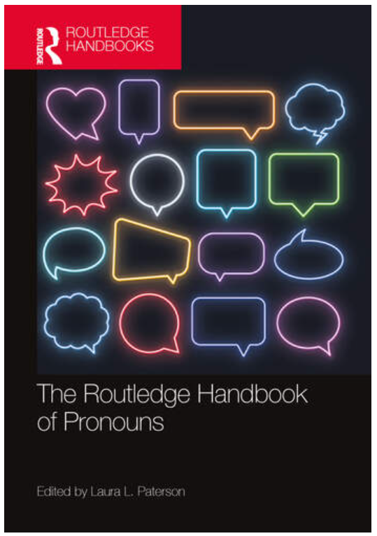
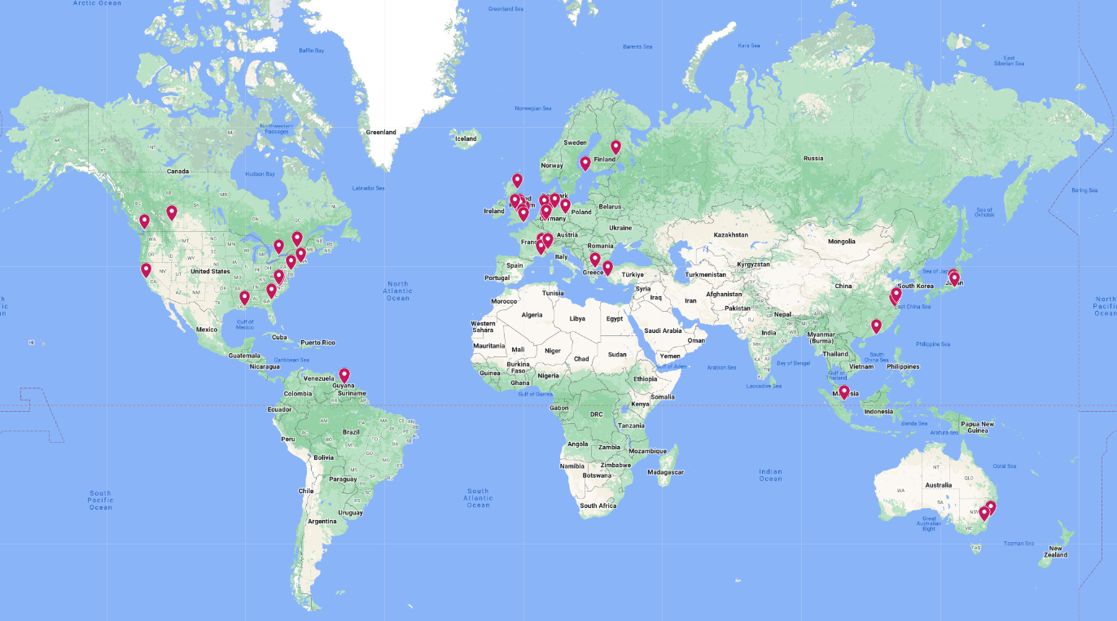
THE ROUTLEDGE HANDBOOK OF PRONOUNS
This volume provides the first state-of-the-art overview of research on pronouns in the 21st century. With its dedicated sections on grammar, history, and change, language learning/acquisition, cognition and comprehension, power, politics, and identity, The Routledge Handbook of Pronouns shows that contemporary interest in pronouns and gender represents just the tip of the iceberg.
A transdisciplinary collection of experts discuss the global history of different pronoun systems, synthesize the literature, and contextualize the salient issues and current debates shaping research on pronouns across different spheres and via different theoretical-methodological traditions. The Handbook is designed to encourage readers to engage with a range of perspectives from within and beyond their immediate areas of interest, with the ultimate aim of shaping the future trajectory of interdisciplinary, multilingual research on pronouns.
Part 1: History and change
Part 2: Processing and categorisation
Part 3: Acquisition and language learning
Part 4: Making pronouns personal
Part 5: Power and politics
Part 6: Gendered pronouns and beyond
35 chapters
20+ Languages
54 scholars (all career stages)
17 different countries

Slide 3
Overview
A brief explanation of how this talk came about
Scene-setting:
Discussion of singular they, combined pronouns, and their role in gender-neutral language reform
Highlight the importance of considering the temporal context of past scholarship and activism in language debates
Contemporary relevance:
Use of pronouns in bios (social media, email signatures, videoconferencing).
There is no singular function of or reason for displaying pronouns
Context (macro, meso, micro) is key
Aim: encourage academic debate

Slide 4
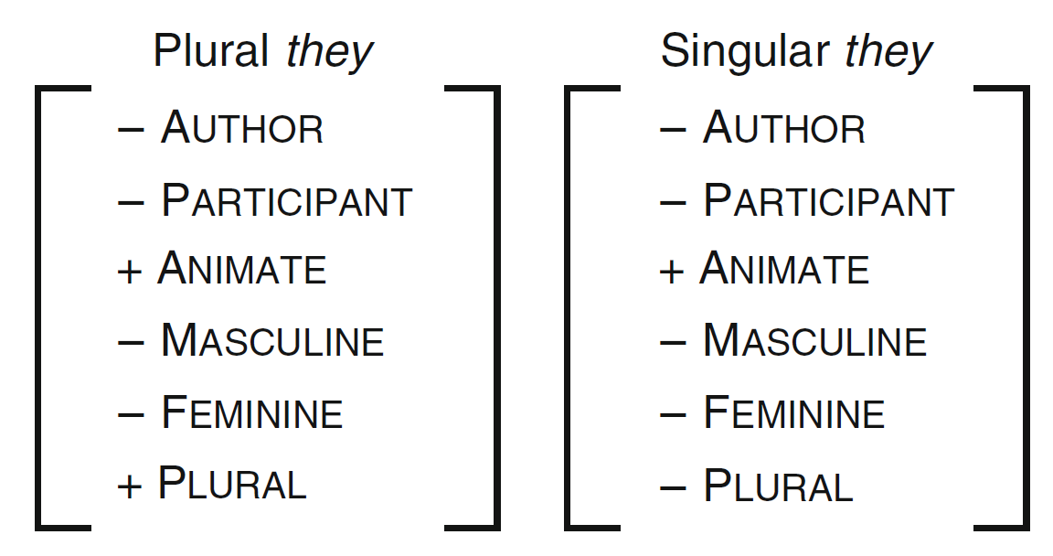
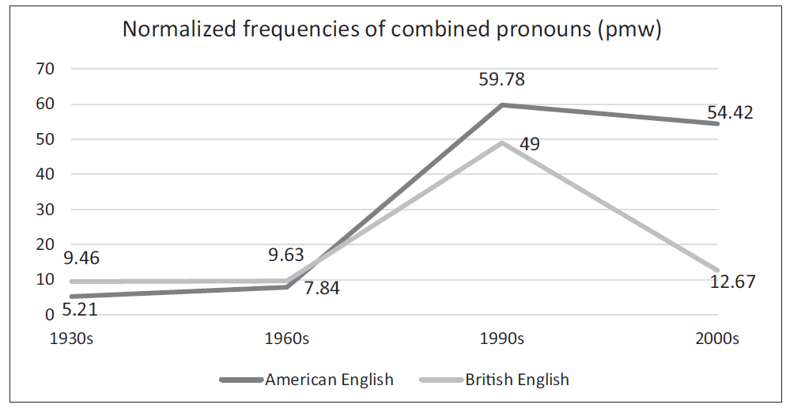
Singular they and combined pronouns
Paterson (2014: 161)
(Paterson 2020: 267)

Slide 5
The importance of context
The gender-neutral language reforms associated with the 1970s/80s onwards must be understood in their historical context
It’s not appropriate to apply a 2024 lens to critique earlier initiatives without acknowledging societal changes
Second-wave feminists advocating for language reform were not necessarily excluding trans and non-binary people, though some may have been
There are cases of trans exclusion that were justified through reference to feminist theories of the late 20th century
But in the 1980s the primary aim was to address the invisibility of women, rather than all genders marginalised by patriarchal/cisnormative structures
Increased public awareness of trans and non-binary individuals is a more recent phenomenon

Slide 6
Gender-neutral or gender-visible?
The reinforcement of the gender binary as realised in combined pronouns, means that ‘gender-neutral language reform’ is a misnomer
‘Gender visible’ is the term I’ll use this morning
Ledin and Lyngfelt’s (2013) taxonomy of hen
Non-binary (the writer/speaker refers to a person with a non-binary gender identity);
Anonymising (the writer/speaker protects the privacy of a person by not disclosing the person’s gender);
Gender-ambiguous (the writer/speaker does not know the gender of the person);
Indefinite (the writer/speaker refers to an abstract/hypothetical person); and,
Generic (the writer[/speaker] refers to a person of any gender)
(Lehecka 2023)
Mapping the taxonomy to they
Non-binary they
Gender-not relevant they
Epicene they
Singular they
Singular they

Slide 7
Gender-visible at the meso/micro levels
The process of adding pronouns to one’s professional bio operates on two levels:
The micro level, as it reflects individual agency
The meso level since different practices emerge in different contexts
This talk will focus on corporate environments and how pronouns are used in the workplace
The affordances of the technologies used are significant, but play a background role

Slide 8
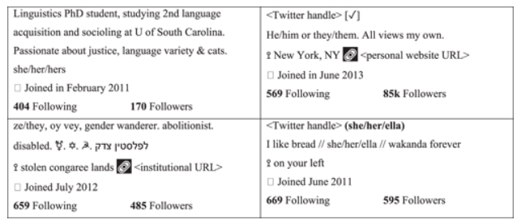
Pronouns in bio
(King and Crowley 2023: 81)
‘the question remains if adding pronouns to the bio can be a superficial act of allyship when trans-inclusive practices do not extend beyond that’
(King and Crowley 2023: 81)

Slide 9
What even are pronouns?
Many examples of opposition to pronoun usage come from individuals who, perhaps, do not fully understand what pronouns are.
On platforms like Reddit and Mumsnet, some individuals:
confuse honorifics (e.g., "Dr" or "your highness") with pronouns
use nouns (e.g., "Piggy," "Lord")
opt for first-person pronouns
intentionally choose non-pronouns as a form of protest
These reactions indicate that the issue is less about pronouns and more about the challenge to traditional gender norms
The understanding that not everyone fits neatly into binary categories disrupts the gendered worldview they have always known
But this does not excuse violence, prejudice, or discrimination in any form.
Mumsnet (2024)
Offer to use 'who, me?'
In the short term use "I, me, mine".
One man has 'Your Highness', which i rather liked.
I’d be tempted to put “Piggy/Moi”.
I quite fancy ‘Fuckface’ as my pronoun
I quite fancy “My pronouns are sex based, like my oppression”
Feminism: Sex and gender discussions
Reddit (2022)
John Smith (get / fucked)
My genders are "lord" and "his majesty" .
NO/YB - None of your business.
Beep/boop
Attack helicopter / Attack helicopter
Dr / Dr, X / X... Just make some stuff up
r/JordanPeterson

Slide 10
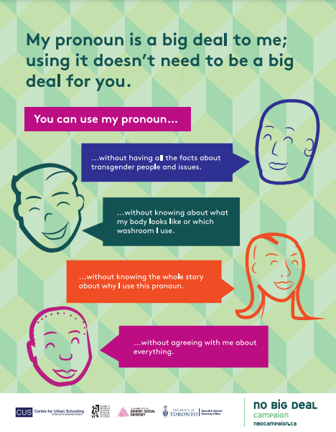
The effort of shifting a world view
Extra effort: labour that is felt to be unremarkable and justifiable by the subject’
Excessive effort: labour that is felt to be remarkable and unjustifiable by the subject (Airton 2018: 795)

Slide 11
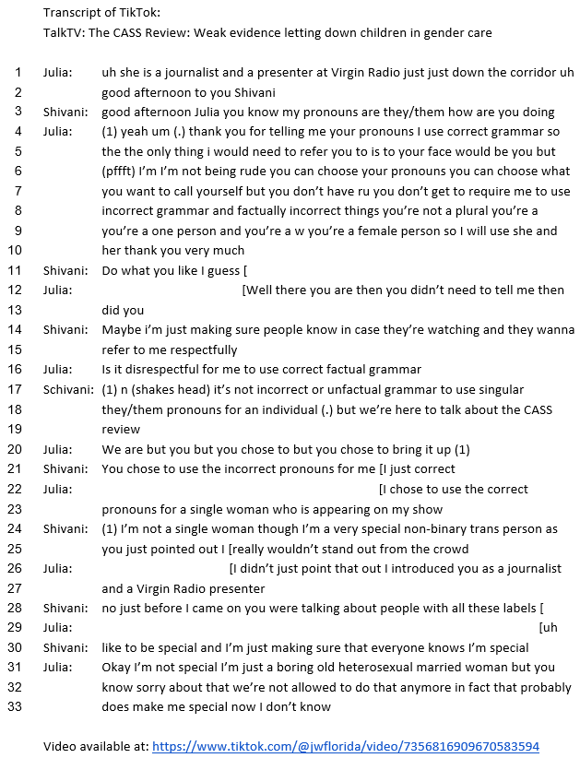
Points of authority

Slide 12
Shifts in style guides
Language evolves over time, though this idea doesn’t always leave academic circles
Lay linguistic arguments, especially appeals to ‘correct’ grammar, have been used to oppose the use of singular they and, to a lesser extent, to promote combined pronouns
History has shown the outcome of such debates; singular they has a long history (Bodine, 1975; Paterson, 2014; Baron, 2021).
Many style guides now endorse it
Non-binary pronouns are not a recent invention; Baron (2021) provides a chronology showing that epicene and neo-pronouns have a long history
While non-binary they may still lag in official endorsements, notable authorities like Merriam-Webster now recognize it
However, official endorsements from ‘language authorities’ won’t automatically change the opinions of those who defend their views with claims of grammatical correctness
We must remember that some individuals use grammar as a cover for expressing anti-LGBTQ+ and trans-exclusive ideologies

Slide 13
Why have your pronouns in your(professional) bio?

Slide 14
Company policy
-Not every company has a specific policy on whether employees can or should put their pronouns in their bio
Many companies have general guidelines about ‘gender-fair language’ and policies against prejudice or discrimination
There may be a legal expectation for companies to ensure fair treatment of employees
Examples
The Bank of England’s Trans Equality Policy (2021) mentions that deliberately using the wrong pronouns could result in disciplinary action, but it doesn’t address adding pronouns to bios
Google’s U.S. policy on harassment, discrimination, and workplace conduct recognizes being transgender as a protected characteristic but makes no mention of pronouns
Slater and Gordon (2022) offer advice on making pronouns visible, suggesting they be added to email signatures, profiles, or name badges, but emphasize that employers shouldn’t force this
While adding pronouns to one’s bio doesn’t seem to be enshrined in many corporate policies, there’s a clear trend of employees doing so, evidenced by media articles, legal blogs, and discussions on platforms like Reddit, Quora, and Mumsnet, etc.

Slide 15
Pronoun visibility: meaning making in corporate contexts
Pronouns in bio
Empowerment
Validation
Struggle
Performance
Distraction
Corporate rainbow washing

Slide 16
A site of empowerment
Adding pronouns to a bio positions individuals as ‘the ultimate authority on their gender identity’ (Zimman, 2019: 147)
Behrensen (2024: 45) compares how Zoom and Facebook handled pronoun options:
Zoom allows users to choose their own pronouns and decide who can see them, offering more agency
Facebook, in contrast, provided a list of fifty options, which imposes choices rather than offering freedom
Who holds the power and what happens if someone's pronoun isn’t listed?
Thus meso-level factors (corporate decisions about software) influence micro-level actions (individual pronoun choices)
Users should have full freedom to write in their own pronouns, rather than being restricted to options deemed ‘acceptable’ by a company
However, allowing free choice also opens the possibility for individuals to use pronouns in their bios as a form of protest

Slide 17
A site of validation
Companies that facilitate the use of pronouns in bios are providing formal validation individuals are recognised (at least in terms of policy)
At the micro level, this is good for an individual
At the meso level, it suggests that a company is a safe place for LGBTQ+ individuals to work
It allows the company to portray an inclusive image to the outside world
What about our working environments?
Having a lecturer who introduced themselves with their name and they/them pronouns during their first class, and proceeded to end each email with their pronouns
When I asked my tutor to respect my pronouns, and they said yes, I understand
Friends and Lecturers defending my pronouns when I’m not present. Lecturers checking with me about where is safe to use my pronouns etc.
(Benato, Fraser and White 2024: 705)

Slide 18
A site of validation
Example 1:
I work at a pet food store franchised by a family consisting of two sisters and one of their partners. The two sisters owned a childhood education facility prior to the pet food store and went to teacher’s college. As a result, one of the sisters feels she can’t use my pronouns because in her mind, “they” is only a plural. I’m misgendered daily by customers, but since they don’t know me, it only makes me uncomfortable and not upset. When one of my bosses misgenders me and refuses to correct herself, it makes me feel frustrated, angry, and small. My usual go-to for correcting people is just to raise a hand and say “they” or “pronouns.” Most of the time it is received well with no backlash, but the one time I tried to correct one of my bosses, I was subjected to an aggressive rant on how she used to be a teacher and she doesn’t believe in using “they/them” for one person and if I won’t let her use “she/her” for me then I’ll have to make do with “he/him.” I haven’t tried to correct her again. With a few exceptions, my workplace is very accommodating. They let me wear my pronoun pin every day so that I have the chance to not be misgendered by our customers, and for that I am grateful. (Val, they/them, Retta 2019)
Example 2:
Thankfully, I don’t interact with many people in my role as a graphic designer, so it’s generally fine and my supervisors are great about it. But once, at an office holiday party, we went to a board game cafe and everyone thought to play Mafia. People kept referring to me with “she/her” pronouns, and by the end of the game I was nearly in tears at what was supposed to be a relaxing, fun work outing. I told them I wanted to sit out because I was being misgendered and people apologized a lot. One person kept asking me if I was okay, but did it in a way that honestly made it feel like it was about him. My supervisor sent me a private email apologizing and promising to do better. (Winnie, they/them, Retta 2019)

Slide 19
A site of validation
Example 3:
For the most part, people were great. However, my boss constantly misgendered me, despite us having a really great conversation about my pronouns at the start of my time there. My boss would mess up and sometimes self-correct, but it happened so often that at a certain point you start to ask yourself—what happened to our conversation? Why am I not respected in my place of work? It makes me feel absolutely invisible and disrespected. When people misgender me it’s because they do not see me as I am—a non-binary person. They see me as my assigned gender at birth and are not putting in the effort to change how they perceive me. It’s possible that because I’m an employee or co-worker people don’t find it necessary to make that level of effort, but what a shit way to be! Maybe we won’t have any form of a relationship outside of this place of work, but I deserve respect.
(Imani they/them Retta 2019)

Slide 20
A site of struggle
Example 4:
Help! I have a new company manager who is asking for everyone's pronouns to be put in their email signature. I like my job and don't want to make a fuss but also don't want to provide them. do you have any ideas how I can politely decline? This is his 3rd email this month. (r/JordanPeterson, Reddit 2022)
Example 5:
Mandatory pronouns on work email signature 146 replies
Morning all
Can one of you ladies point me in the right direction of the wording I can use to fight against this? I do remember seeing links but just a quick reference will be appreciated
Basically my very laid back non political company is as taken over last year by a huge US corp and since then very bit of training is revolved around DEI and being told the ‘correct’ way to think. Email pronouns were rolled out on a voluntary basis with the vast majority of the UK based staff not partaking. This hasn’t gone down well with the big cheeses in the US and they’re bringing in an AI email tool where pronouns are a mandatory field.
Now this is 💯 a fight I’m prepared to take on and my entire team feel the same - none of us want this nonsense. So just really looking for wording to use to put on a team pushback against this unnecessary compelled crap.
Any links/wording/examples to quote would be very much appreciated - this really is a hill we’re all ready to die on. Thank you
(Feminism: Sex and gender discussions, Mumsnet 2024)
Who is positioned as struggling?
Those who want their pronouns visible
Those who don’t want to provide pronouns
Those who don’t want to acknowledge others’ pronouns
Opposition as victimhood (Turner et al. 2018)

Slide 21
Out woking to avoid policy
Example 6:
cant link it as in a rush but the Yogyakarta Principles which is THE transgender rights document says in no 6 or 16 that this should not happen as it outs people who may not be ready. You can search on here for previous discussions. Basically, you outwoke them by showing they are being transphobic. Worked beautifully for me
(Feminism: Sex and gender discussions, Mumsnet 2024)
Example 7:
Personally I would not go with this suggestion because while it may work, you are essentially lying to your employer. You're invoking something you don't believe in to get the result you want.
Your employer will likely clock this as the dishonesty that it is, because they're not stupid. Unless you genuinely are acting out of sensitivity towards gender-confused people who aren't ready to come out yet I suppose.
The better approach is the honest one, raising your genuine concerns and the law if necessary.
Sorry I don't have any positive advice here, but I don't think dishonestly 'outwoking' your HR department is the smart move here.
(Feminism: Sex and gender discussions, Mumsnet 2024)
Example 8:
I don't necessarily agree. I am completely gender critical and have several reasons for not being prepared to engage with this nonsense, but that doesn't mean I can't also recognise what a virtue-signalling hypocrisy it is for this reason. Forcing everyone to declare pronouns is not universally supportive of trans people.
(Feminism: Sex and gender discussions, Mumsnet 2024)

Slide 22
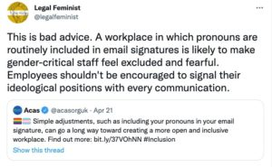
Ranking protected characteristics
Example 9:
I can't take credit, not my words or suggestion, however I saw this on a similar thread recently and I've saved it in my phone for the inevitable day when my employer decides this is also a thing. It's fantastic, simply say:
‘As a Christian I have gender critical beliefs'.
Because... "If they come for you they come for your religion and then, they're fucked."
(Feminism: Sex and gender discussions, Mumsnet 2024)
Example 11:
Tell him it’s a violation of federal law to force employees to engage in religious activity via Title VII of Civil Rights Act of 1964.
Wokism is a religion (more like a cult, actually) not different than traditional ones like Christianity, Islam, etc - shares all the same characteristics like idols, dogmas, martyrs & saints, rituals, etc.
(r/JordanPeterson, Reddit 2022)
Example 10:
Be King/His highness, and be ready to shoot an email to CNN & the woke mob if your manager takes offense, tries to fire you or doesn't use your pronouns accordingly. Beat them at their own game.
(r/JordanPeterson, Reddit 2022)

Slide 23
A site of performance
Pronouns do index gender identities, making them part of the performative nature of gender.
Neopronouns index a position outside the gendered expectations or connotations associated with binary pronouns
The syntactic or discourse functions of pronouns as those functions remain unchallenged
But performance has another meaning
Val wore a pronoun badge at work but was still misgendered by their boss
Pronoun policies have been dismissed as ‘virtue signalling hypocrisy’

Slide 24
A site of distraction
Pronouns represent a small aspect of gender identity indexing
Do discussions about pronouns overshadow other issues:
Workplace discrimination (McFadden and Crowley-Henry, 2016).
Low-quality medical care (Borba, 2017).
Physical violence (Closson, Boyce, and Johns, 2024).
Less emphasis on pronouns wouldn’t necessarily result in increased attention to other significant issues.
Narrowing identity discussions to language may serve as a distraction arising from:
A lack of ability to articulate deeper arguments on identity and social freedoms
Concerns about repercussions for expressing anti-trans views

Slide 25
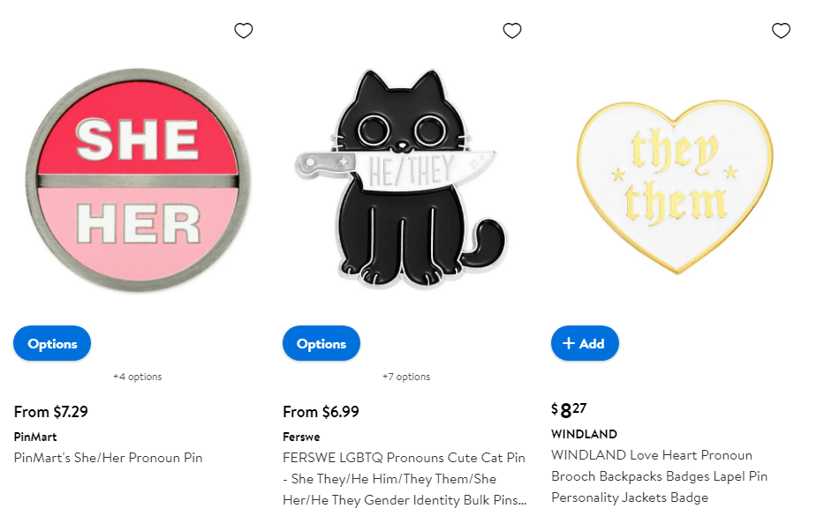
A site of corporate rainbow washing
‘Put simply, rainbow-washing is the practice of using rainbow-themed symbolism in branding, advertising, merchandise or social media, ostensibly in solidarity with LGBTQ+ people during pride month, but without active support of LGBTQ+ people’s identities or rights’ (Bandera 2024).
Pride Every Day: Supporting LGBTQ+ Associates and the Communities We Serve
Inclusion: Encouraging associates to bring their authentic selves to work every day often begins with something as basic as a name. A person’s name is the greatest connection to their own individuality and should be recognized consistently across all parts of the company. We are continuing to update our systems and processes to enable preferred name usage. Additionally, associates can now self-identify their sexual orientation, gender identity and pronouns should they choose to do so. The preferred name and self-identification initiatives are just a few examples of our efforts to create a workplace of inclusion and belonging.
(Morris 2022)
(https://www.walmart.com/c/kp/pronouns-pins)

Slide 26
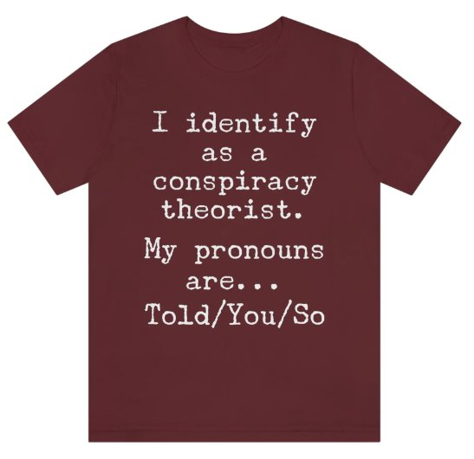
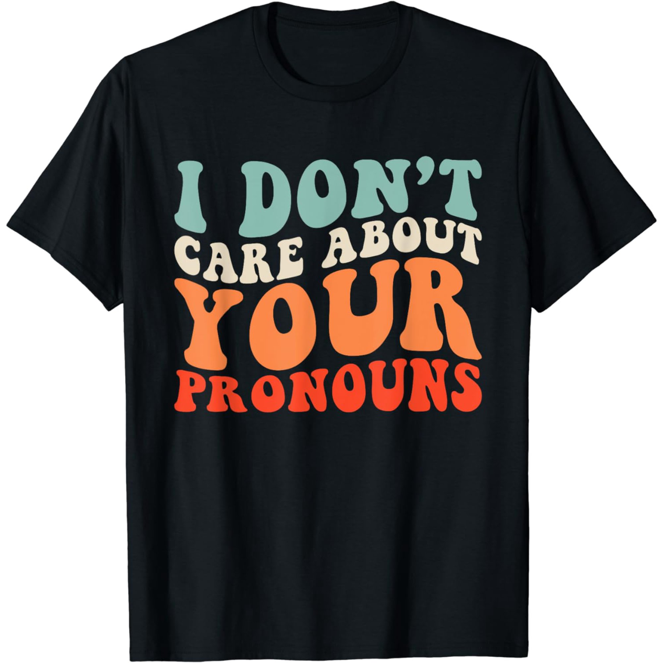
Washing Walmart clean

Slide 27
Conclusions
The many functions of pronouns in bios
Pronouns can represent a site of empowerment and validation
They serve as a means of self-identification and affirmation
The use of pronouns can reflect ongoing struggles for recognition and equality
Distraction and corporate rainbow washing:
A focus on pronouns may distract from deeper issues of social justice
Corporate adoption of pronouns may sometimes be seen as insincere or performative
But, regardless of intent, the inclusion of pronouns, particularly non-binary pronouns, enhances visibility
The meaning of pronouns in bios varies based on context
Macro Level: Focus on broader social justice issues
Meso Level: Consideration of inclusive practices and LGBTQ+ visibility in specific settings
Micro Level: Individual needs and personal identification

Slide 28
A note on transparency

Slide 29
References
Airton, L. 2018. The de/politicization of pronouns: implications of the No Big Deal Campaign for gender-expansive educational policy and practice. Gender and Education 30(6): 790-810.
Arnold, J.E., H.C. Mayo and L. Dong. 2021. My pronouns are they/them: Talking about pronouns changes how pronouns are understood. Psychonomic Bulletin and Review 28: 1688–1697.
Bandera, G. 2024. Genuine Pride or corporate rainbow washing? Fair Planet. Available at: https://www.fairplanet.org/story/how-to-combat-corporate-pinkwashing-in-pride-month/ (accessed 15/10/24).
Bank of England. 2021. Trans Equality Policy. Available at: https://www.bankofengland.co.uk/-/media/boe/files/freedom-of-information/2021/trans-equality-policy.pdf (accessed 01/10/2024).
Barker, M. 2022. LGBTQ+ Pride: Firms accused of 'rainbow-washing'. BBC. Available at: https://www.bbc.co.uk/news/uk-wales-62597165 (accessed 10/10/24).
Baron, D. 2021. What’s Your Pronoun? New York: Liveright.
Behrensen, M. 2024. Technology and pronouns: disrupting the ‘Natural Attitude about Gender’. Ethics and Information Technology 26: 45.
Benato, R., J. Fraser and F.R. White. 2024. Getting beyond peeing and pronouns: living non-binary gender in higher education. Journal of Gender Studies 33(5): 698-710.
Bodine, A. 1975. Androcentrism in prescriptive grammar: Singular ‘they’, sex-indefinite ‘he’, and ‘he or she’. Language in Society 4: 129–146.
Borba. R. 2017. The banality of evil. Journal of Language and Discrimination 1(1): 7-33.
Bradley, E.D. 2023. The influence of linguistic and social attitudes on grammaticality judgments of singular ‘they’. Language Sciences 78: 1011272.
Claxton, H. 2022. Do employees have to use gender pronouns in email signatures? Available at: https://www.jonathanlea.net/blog/do-employees-have-to-use-gender-pronouns-in-email-signatures/ (accessed 30/09/24).
Closson, K., S.C. Boyce, N. Johns, D.J. Inwards-Breland, E.E. Thomas and A. Raj. 2024. physical, sexual, and intimate partner violence among transgender and gender-diverse individuals. JAMA Network Open 7(6) :e2419137.
Google. n.d. Policy on harassment, discrimination, retaliation, standards of conduct, and workplace concerns (US). Available at: https://services.google.com/fh/files/blogs/policy_workplace_concerns.pdf (accessed 01/07/2024).
Jiang, J., E. Chen, L. Luceri, G. Murić, F. Pierri, H.C.H Chang E. and Ferrara, E. 2022. What are your pronouns? Examining gender pronoun usage on twitter. Workshop Proceedings of the 17th International AAAI Conference on Web and Social Media doi: 10.36190/2023.02.
Jones, L. 2023. ‘I'm a boy, can't you see that?’: Dialogic embodiment and the construction of agency in trans youth discourse. Language in Society 52(4): 549-570.
Kerney, M.A., A. Singh, K. Vigil, C.N. Hargons and N. Malone. 2024. Pronouns and experiences of misgendering among nonbinary black womxn. Psychology of Sexual Orientation and Gender Diversity [online first]
King, B.W. and A. Crowley. 2023. The future of pronouns in the online/offline nexus. In L.L. Paterson (ed.) The Routledge Handbook of Pronouns. New York: Routledge. pp 74-86.
Ledin, P. and B. Lyngfelt. 2013. ‘Olika hen-syn: Om bruket av hen i bloggar, tidningstext och studentuppsatser’. Språk och stil 23(1): 141–74.

Slide 30
References
Lehecka, T. 2023. Antecedents of a novel gender-neutral pronoun: a corpus-based approach to pronoun reference in Swedish. Corpora 18(3): 329-356.
McFadden, C. and M. Crowley-Henry. 2016. A systematic literature review on trans* careers and workplace experiences. In T. Köllen (ed.) Sexual Orientation and Transgender Issues in Organizations. Cambridge: Springer.
Mumsnet. 2024. Feminism: Sex and gender discussions. Available at: https://www.mumsnet.com/talk/womens_rights/5074697-mandatory-pronouns-on-work-email-signature (accessed 15/10/24).
Paterson, L.L. 2014. British Pronoun Use, Prescription, and Processing. Linguistic and Social Influences Affecting ‘They’ and ‘He’. London: Palgrave Macmillan.
Paterson, L.L. 2020. Non-sexist language policy and the rise (and fall?) of combined pronouns in British and American written English. Journal of English Linguistics 48(3): 258–281.
Redditt. 2022. r/JordanPeterson. Available at: https://www.reddit.com/r/JordanPeterson/comments/wttwtd/help_i_have_a_new_company_manager_who_is_asking/?captcha=1 (accessed 15/09/24).
Reilly-Thorton, A. 2023. Gender-neutrality and clitics. In L.L. Paterson (ed.) The Routledge Handbook of Pronouns. New York: Routledge. pp 421-436.
Retta, M. 2019. Work Sucks, Especially When People Get Your Pronouns Wrong. Available at: https://www.vice.com/en/article/pronouns-at-work-trans-nonbinary/ (accessed 10/08/2024).
Slater and Gordon. 2022. Using pronouns in the workplace. Available at: https://www.slatergordon.co.uk/newsroom/using-pronouns-in-the-workplace/#:~:text=It's%20important%20to%20note%2C%20however,to%20share%20their%20gender%20identity (accessed 01/10/24).
Steriopoli, O. and H. Aussoleil. 2023. Individuals’ pronoun choice: A case study of transgender speakers in Berlin. In L.L. Paterson (ed.) The Routledge Handbook of Pronouns. New York: Routledge. pp 465-479.
Symonds, M. 2022. How To Detect Rainbow Washing Versus Genuine LGBTQ+ Support. Forbes. Available at: https://www.forbes.com/sites/mattsymonds/2024/06/26/how-to-detect-rainbow-washing-versus-genuine-lgbtq-support/ (accessed 15/10/24).
Turner, G., S. Mills, I. van der Bom, L. Coffey-Glover, L.L. Paterson and L. Jones. 2018. Opposition as victimhood in media debates about same-sex marriage. Discourse & Society 29(2): 180–197.
Zimman, L. 2019. Trans self-identification and the language of neoliberal selfhood: Agency, power, and the limits of monologic discourse. International Journal of the Sociology of Language 256: 147-175.

